Slide 1

Spatial Data Infrastructure (SDI) at the Geological Survey of Norway
By Frank Haugan
Notes:
A framework of technologies, policies, and institutional arrangements that together facilitate the creation, exchange, and use of geospatial data and related information resources across an information-sharing community.
Such a framework can be implemented narrowly to enable the sharing of geospatial information within an organization, such as the Geological Survey of Norway or more broadly for use at a national, regional, or global level. In all cases, an SDI will provide an institutionally authorized, automated means for posting, discovering, evaluating, and exchanging geospatial information by participating information producers and users.

Slide 2

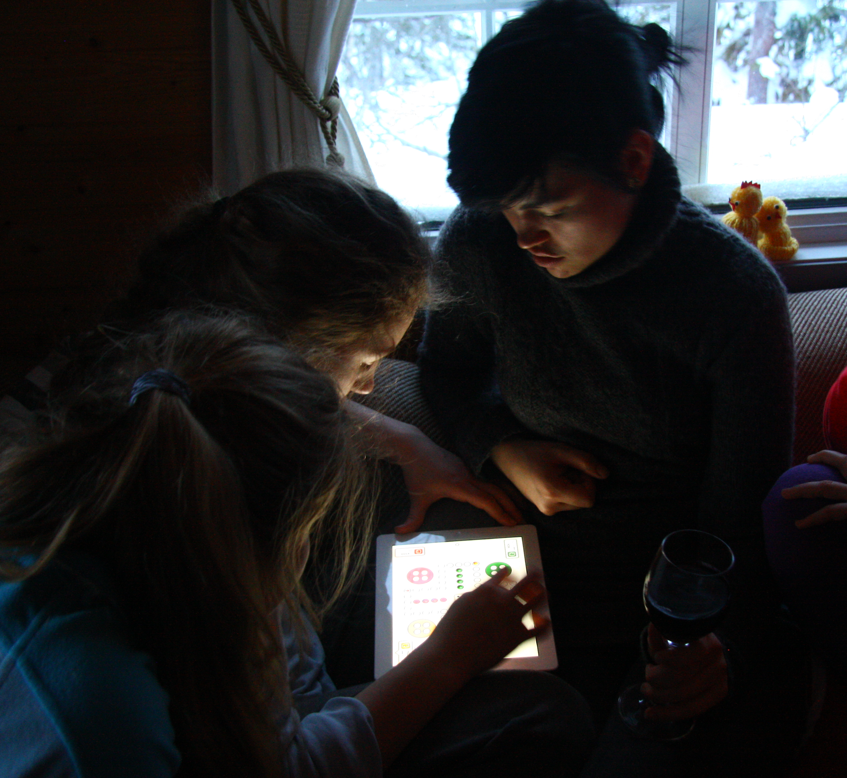
Spatial Data
Infrastructure
Notes:
institutional arrangements – policies - technologies

Slide 3

Users
Society
GIS
GIS
Institutionalised
Municipality
GIS
GIS Program
GIS Projects
1987
1991
1998
2003 →
Complexity

Slide 4
The stairway of services
Complexity and user orientation in Governmental digital services
STEP 4:
Integration and interaction
User orientation
STEP 3:
Information for individual use
STEP 2:
Target group communication
STEP 1:
Publishing - brochure on the Internet
Complexity/gains
Notes:
Step 1: General information about the Agencies and its services
Step 2: Presentation of information and simple interactive services
Step 3: Services that offers the user to provide and collect information prepared for the user. These services is closely dependent upon the internal IT at the Agency. Referred often to as vertical integration.
Step 4: Services which requires organisation and technological interaction between Agencies or Enterprices, referred to as horizontal integration. These services might provide data and/or services from other Enterprices and present it as a service in other systems.

Slide 5
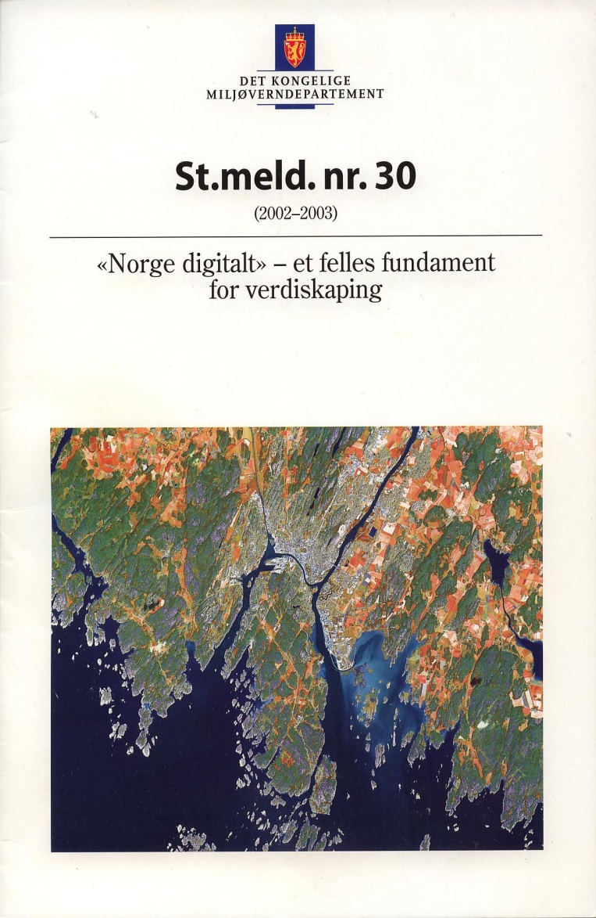




Norway digital and INSPIRE compliant
Parliamentary White Paper 2003
Strategy for electronic content
eNorge 2005 and 2009 plan
Notes:
Norway Digital is the Norwegian government's initiative to build the national geographical infrastructure. Norway Digital is since 2005 a working co-operation and infrastructure with reference data and thematic data available, more than 100 operational web map services, geoportal and other services. Thus Norway Digital is an existing implementation of the infrastructure described by the European Inspire-directive.

Slide 6

Norway digital and INSPIRE compliant
The Norwegian national standard on geographic information - SOSI
Notes:
Norway Digital is a result of many years of work on standardisation and user orientation on Governmental sector. The Norwegian national standard on geographic information (SOSI) started in 1984 with participation of Geological Survey of Norway since 1991 in: SOSI WG 1 – techniques, models and metadata and SOSI WG 6 – natural resources. The SOSI feature catalogue contains 11 chapters with description on geosciences information.
Establishing an infrastructure for spatial information in the Community (INSPIRE) was adopted May 2007. Again NGU very much involved in the work and is representing Geology in the standardisation processes. We provide our expertise both in SOSI and INSPIRE working groups and the following slides will show you what kind of expertise.

Slide 7
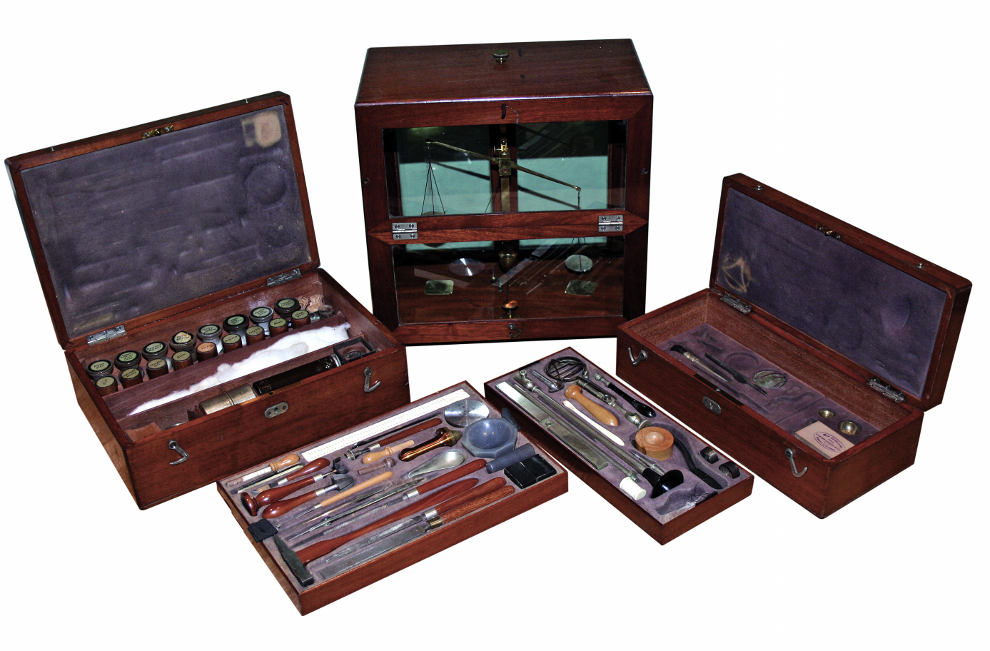
Technology

Slide 8
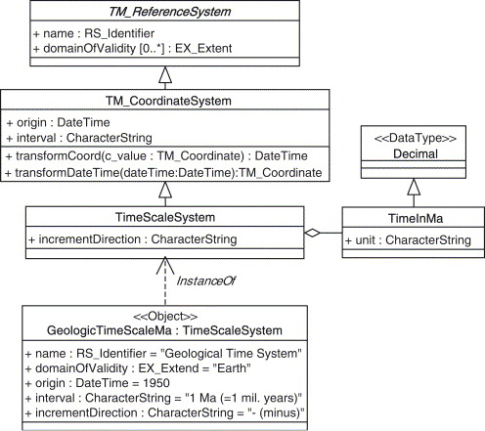
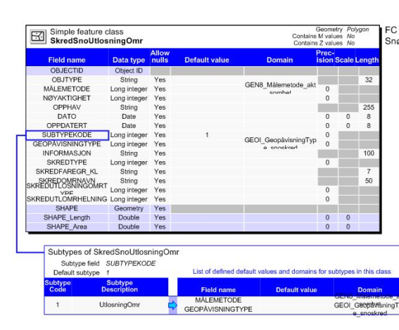
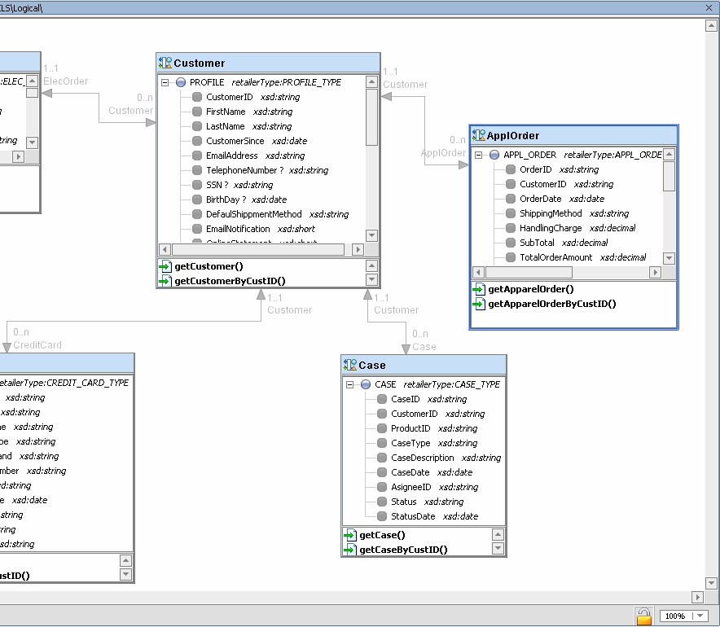
Technology - Design methods
Conceptual model
SOSI standard UML models
(in Enterprise Architect)
Logical model
System dependent
(ESRI model tools)
Physical model
System independent
(Oracle database)

Slide 9
Technology - Database
management system
ARCSDE/ORACLE
State of the art software
Standard interfaces
Standard Feature Catalogues
Standardised Metadata
Sand and
gravel
Paleo
climate
Geophysic
Landslides
Ground
water
Soil
METADATA
Bedrock
Marine-
geology
Geo
chemistry
Structural
geology
Mineral-
resources
Notes:
Our decision is to use ArcGIS/ArcSDE from ESRI and Oracle as our basic data management systems.

Slide 10
Technology - Services and tools
Map services
Factsheet
(PL/SQL)
Internet
GetFeatureInfo()
WMS-Clients
WMS
(MapServer)
Marine, minerals, bedrock, etc
ArcSDE/Oracle
Other clients
AGS-service
(ArcGIS Server)
Notes:
Services for datasets. Styled factsheet programmed in PL/SQL

Slide 11
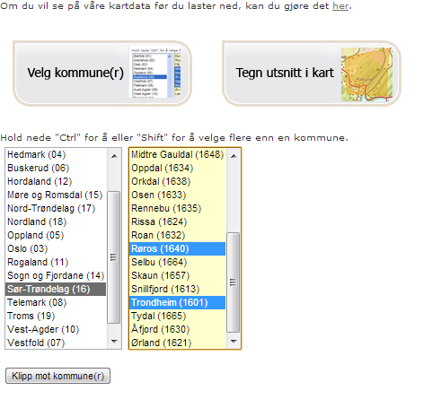
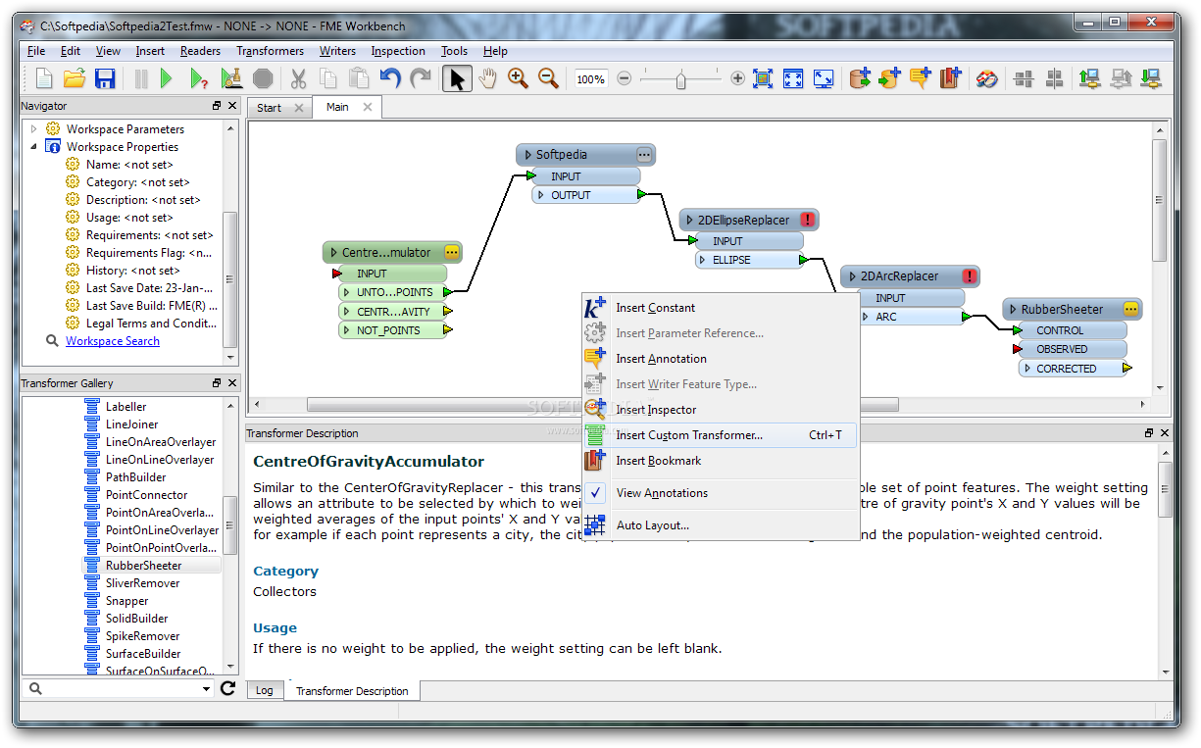
Technology - Services and tools
Downloading
Notes:
Precondition is the development of data models from SOSI feature catalogue, product spesifications and SDE-VIEWS in ORACLE.
Infrastrucure (2 servers: test/migration + prod)
• FME Server 2011 SP3 (SAFE)
• FME Desktop 2011 SP3 (SAFE)
• GeoSOSI Professional (Geodata AS)
• ArcGIS Desktop 10.x (ESRI)
• Tomcat 6.x / Java 6.x (Open source)
• NGU python-script for managing attachements

Slide 12
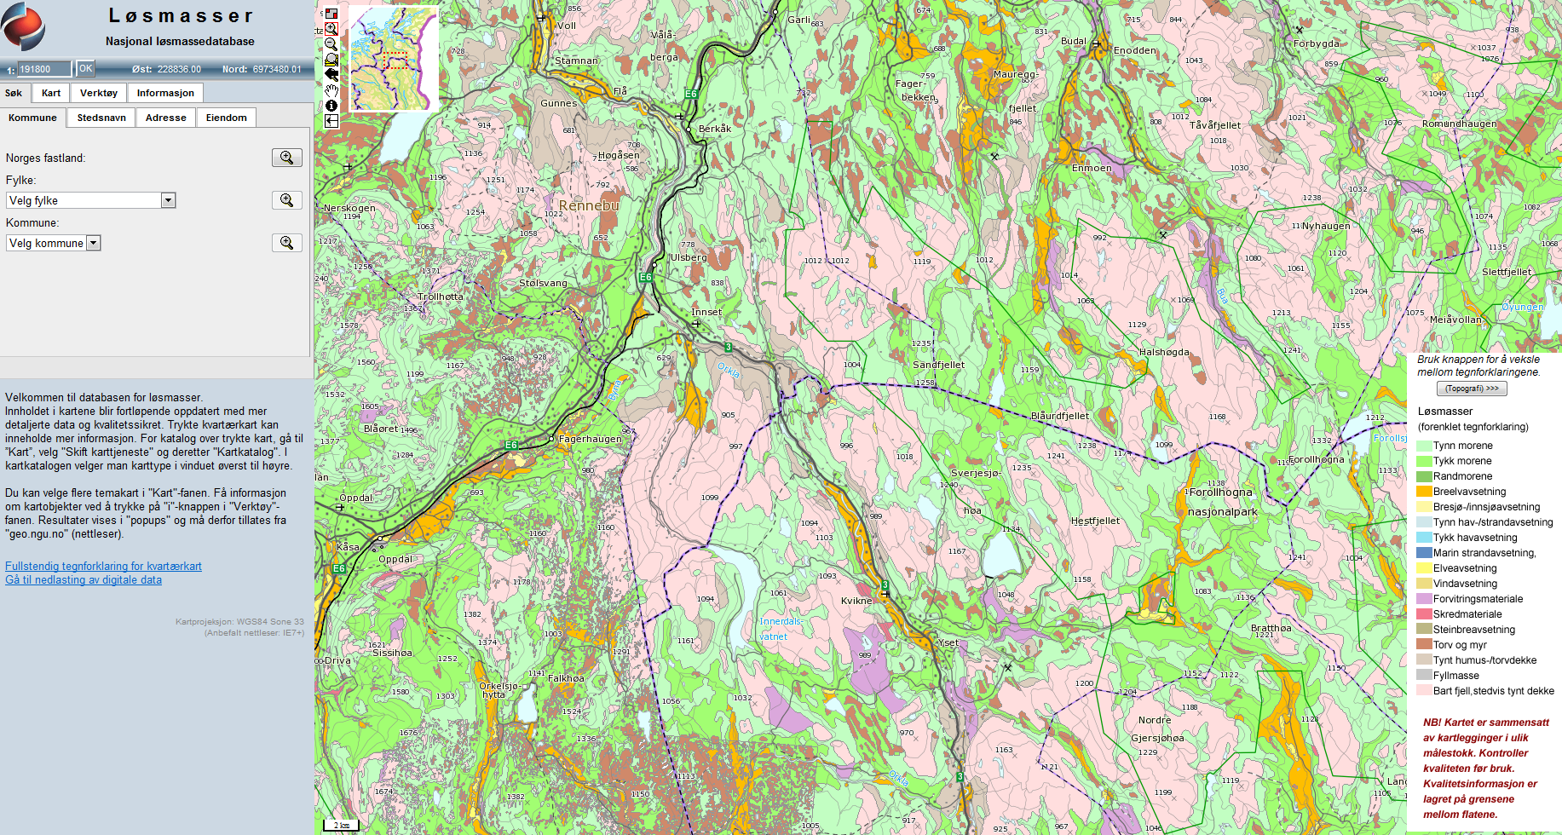
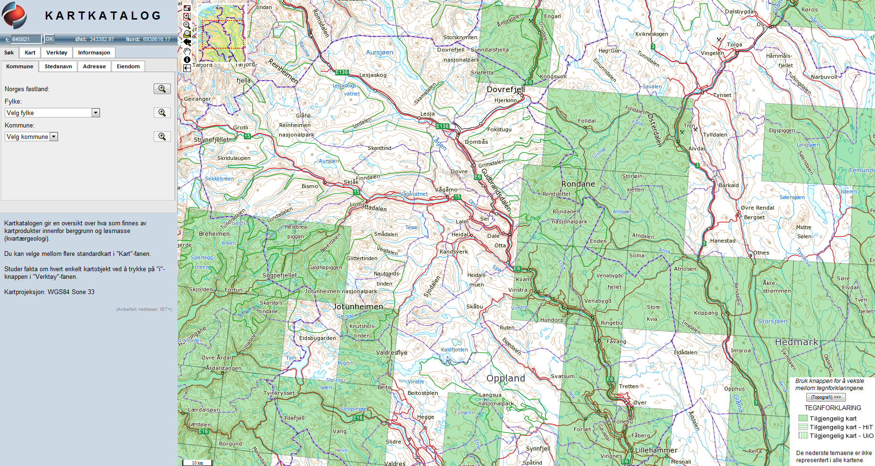
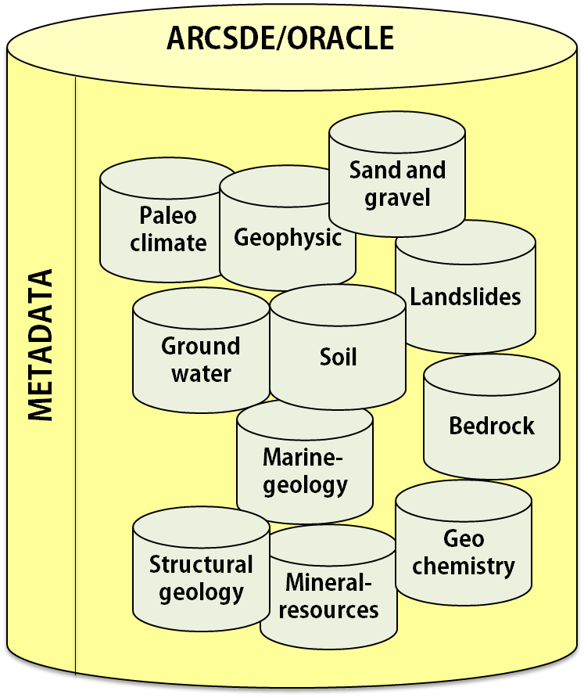
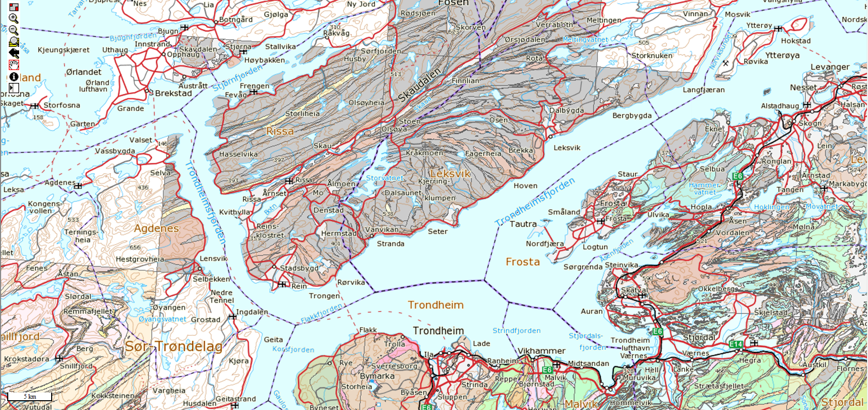
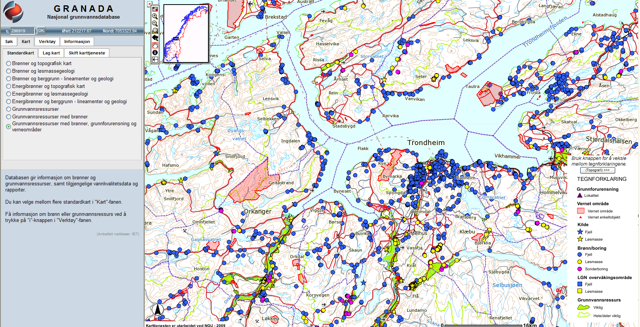
Technology - Services and tools
MapClients
Notes:
Most are implemented using Java og Java Servlets. JSP/JSTL, Javascript and CSS in presentation. MVC designpattern (Model View Controller)
Most important Java frameworks (pom.xml):
• Spring; Core, Webflow and Security
• JSP, JSTL, Java Servlets
• Apache commons, Apache Tiles, SLF4J, Junit/Mockito for testing
• OpenLayers
• Jquery; UserInterface, Form, tabSlideOut
• Spry Tooltip

Slide 13
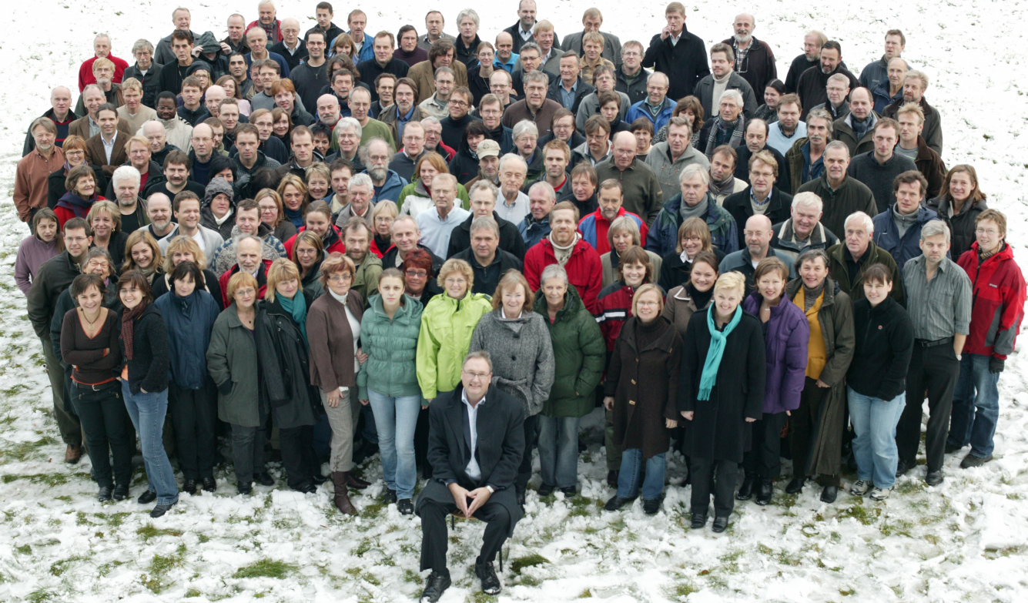
Knowledge

Slide 14
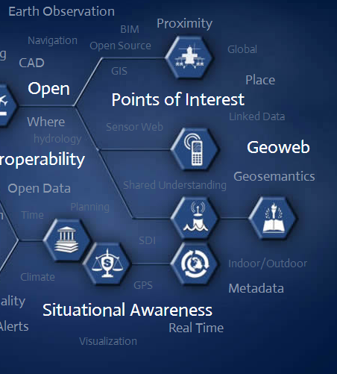


The way ahead
Data
integrity
More intuitive
maps and services
Hunting
for heads
Notes:
Data integrity: Our SDI technology shall integrate with service-oriented architecture (SOA) principles that support existing IT, Web, and geospatial interoperability standards, including the industry specifications of the Open Geospatial Consortium (OGC). Enhanced security features and policies controlling record-level metadata access ensure the right data is available to the users who need it.
More intuitive maps and services: Aiming at being on step 4 at the Stairway of services require more easily accessible information on all levels of society. Knowing the expectation of the younger generation, both the common user and the newly educated university students, will expect institutions like NGU to be technologically up to date and provide maps and services that are intuitive on all types of platforms.
Hunting for heads: We have to work continuously toward the Universities and society to make sure we are competitive in recruiting personnel with the acceptable level of competence for NGU.

